Slide 1
KEYLOGGER PROJECT
CAPSTONE PROJECT
Presented By:
S.K.Anulatha - College of Engineering Guindy , Anna University
Roll number: 2021115014

Slide 2
OUTLINE
Problem Statement
Proposed System/Solution
System Development Approach
Algorithm & Deployment
Result (Output Image)
Conclusion
Future Scope
References

Slide 3
PROBLEM STATEMENT
In today's digital age, where cybersecurity threats loom large, one of the significant concerns is the proliferation of keyloggers, stealthy software tools designed to monitor and record keystrokes on a user's computer without their knowledge. Keyloggers pose a severe threat to individuals and organizations as they can capture sensitive information such as passwords, credit card details, and other personal data, leading to identity theft, financial loss, and privacy breaches.

Slide 4
PROPOSED SOLUTION
Objectives and Scope Definition:
Clearly outline the objectives and scope of the keylogger system, specifying its intended purpose and ethical considerations.
Platform and Language Selection:
Determine the target platform(s) for the keylogger (e.g., Windows, macOS, Linux) and select the appropriate programming language (e.g., Python, C++) for development.
Data Capture:
Identify the data to be recorded by the keylogger, including keystrokes, timestamps, and window titles. Implement functions to securely capture and store this data, taking into account privacy and security concerns.
Data Processing:
Clean and preprocess the captured data to remove sensitive or irrelevant information. Encrypt the stored data to maintain confidentiality and integrity.
Stealth Mode Integration:
Incorporate techniques to enable the keylogger to operate stealthily, evading user detection and antivirus software. Implement methods to conceal the keylogger process from task managers and system monitoring tools.

Slide 5
PROPOSED SOLUTION
Logging and Storage:
Develop a logging mechanism for storing the captured data locally or remotely, as per requirements. Include functionality to periodically upload logged data to a secure server or cloud storage for remote access.
Error Handling and Reliability:
Integrate robust error handling mechanisms to manage exceptions and ensure the keylogger's reliability. Monitor system resources and disk space to prevent crashes or data loss due to resource constraints.
Testing and Assessment:
Conduct comprehensive testing of the keylogger across various scenarios to validate its functionality and reliability. Evaluate its performance in terms of data capture accuracy, stealthiness, and resource utilization.
Documentation and Compliance:
Thoroughly document the keylogger system, detailing its design, implementation specifics, and usage guidelines. Ensure compliance with pertinent laws and regulations governing keylogger creation and usage, including obtaining appropriate authorization and consent.

Slide 6
SYSTEM APPROACH
The "System Approach" section outlines the overall strategy and methodology for developing and implementing the rental bike prediction system. Here's a suggested structure for this section:
System requirements
Library required to build the model
module -pynput,jsonlib
python idle

Slide 7
ALGORITHM & DEPLOYMENT
Importing Required Libraries:
The script begins by importing necessary libraries, including tkinter for GUI development, keyboard from pynput for capturing keyboard events, and json for handling JSON data.
Global Variable Initialization:
Initialization of global variables:
- keys_used: A list to store information regarding pressed, held, and released keys.
- flag: A boolean variable used to track if a key is being held.
- keys: A string variable to hold the sequence of keys pressed.
Functions Definition:
The script defines several functions for various purposes:
- generate_text_log(key): Writes the pressed keys to a text file named "key_log.txt".
- generate_json_file(keys_used): Stores the captured keys in a JSON file named "key_log.json".
- on_press(key): Invoked upon key press, adds the pressed or held key to keys_used list and generates the JSON file.

Slide 8
ALGORITHM & DEPLOYMENT
Functions Definition:
- on_release(key): Invoked upon key release, adds the released key to keys_used list, updates the keys string, and generates both text and JSON log files.
- start_keylogger(): Initiates the keylogger by starting the listener and updating the GUI interface.
- stop_keylogger(): Halts the keylogger by stopping the listener and updating the GUI interface.
GUI Creation:
The script creates a basic GUI window using tkinter library, comprising two buttons: "Start" and "Stop", along with a label indicating the keylogger status.
Main Functionality:
When the user clicks the "Start" button, the keylogger initializes by invoking the start_keylogger() function.
Upon clicking the "Stop" button, the keylogger ceases its operation through the stop_keylogger() function.
Event Handling:
Keyboard events are captured utilizing the pynput library's Listener class.
The on_press() and on_release() functions are triggered upon key press and release, respectively.

Slide 9

RESULT

Slide 10
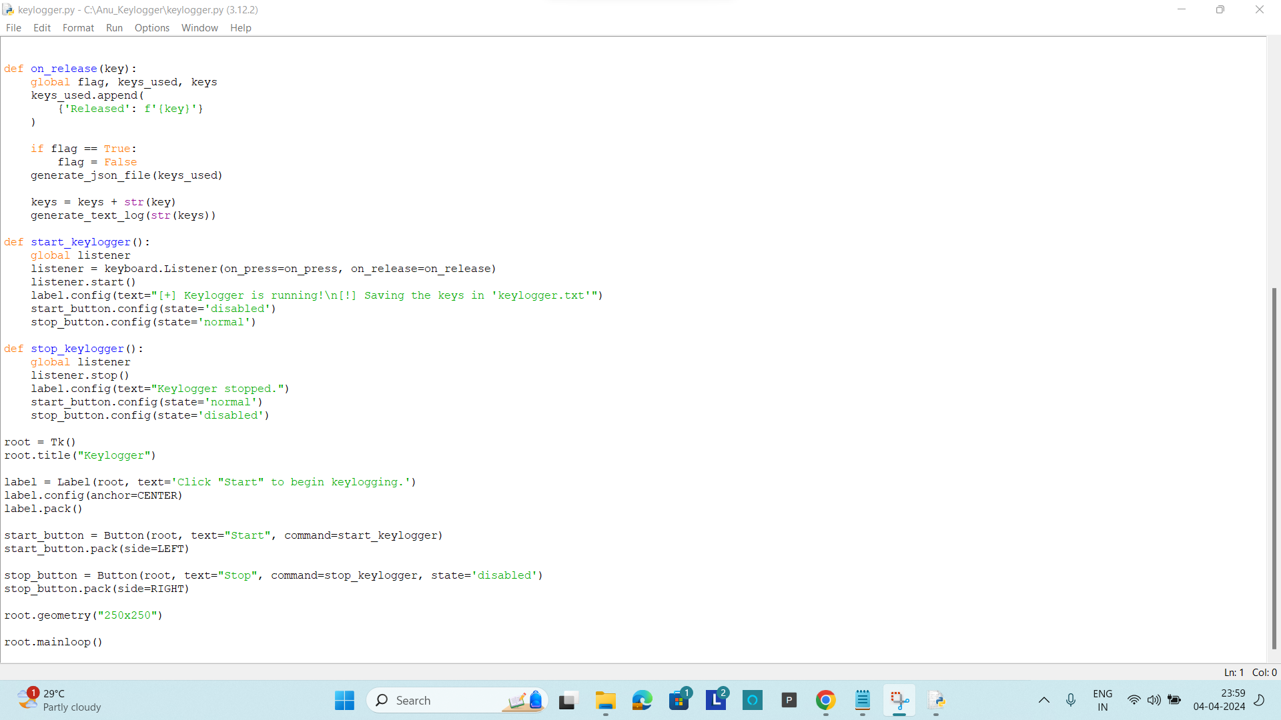
RESULT

Slide 11
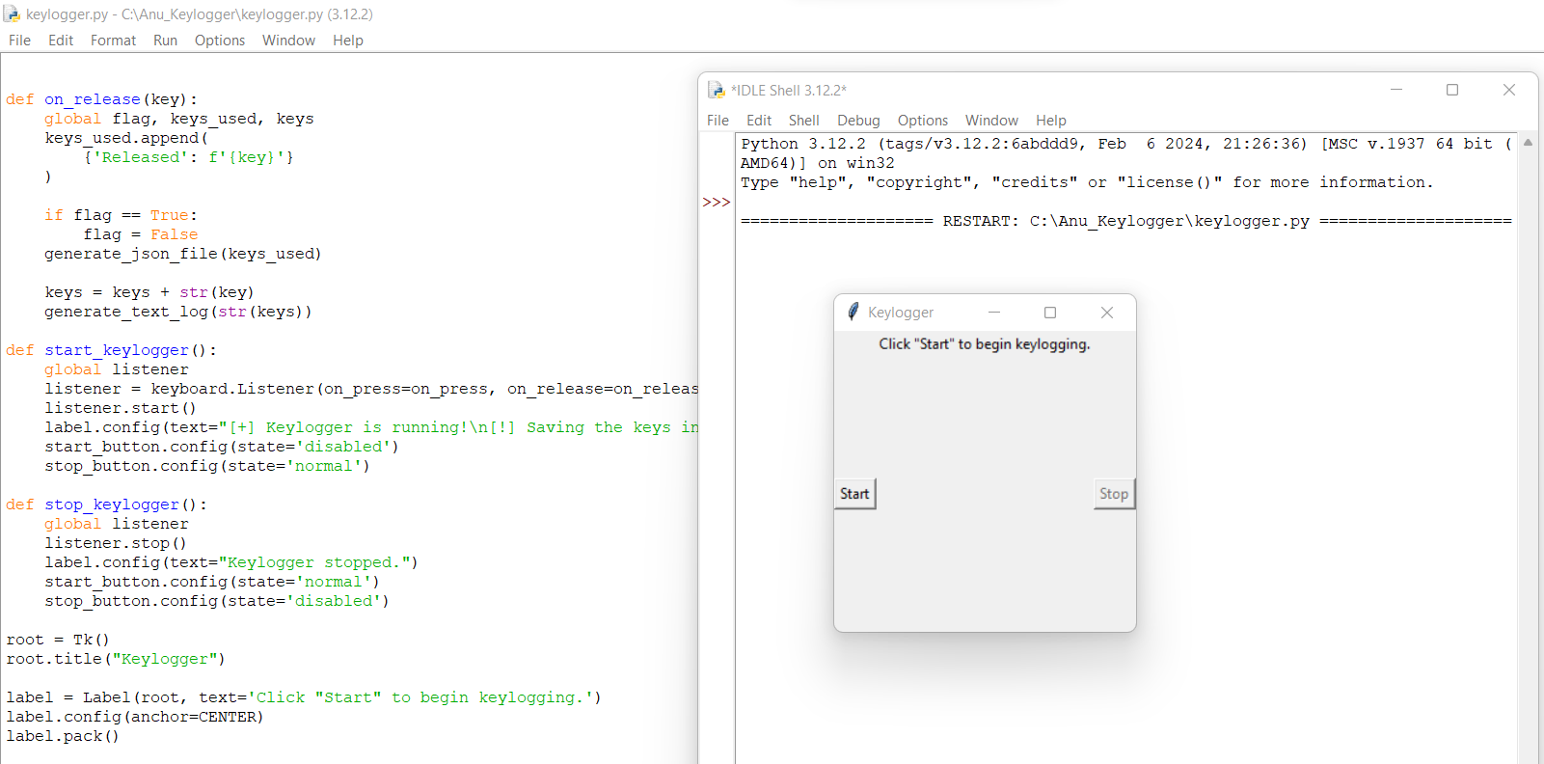
RESULT

Slide 12
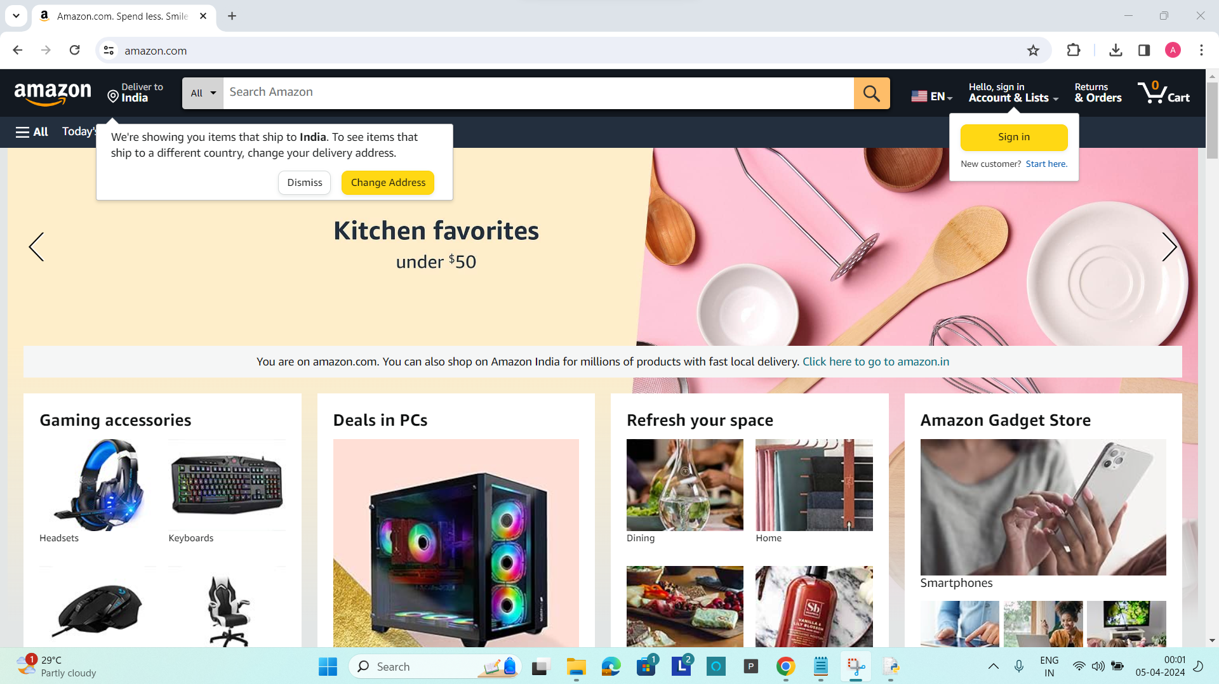
RESULT

Slide 13
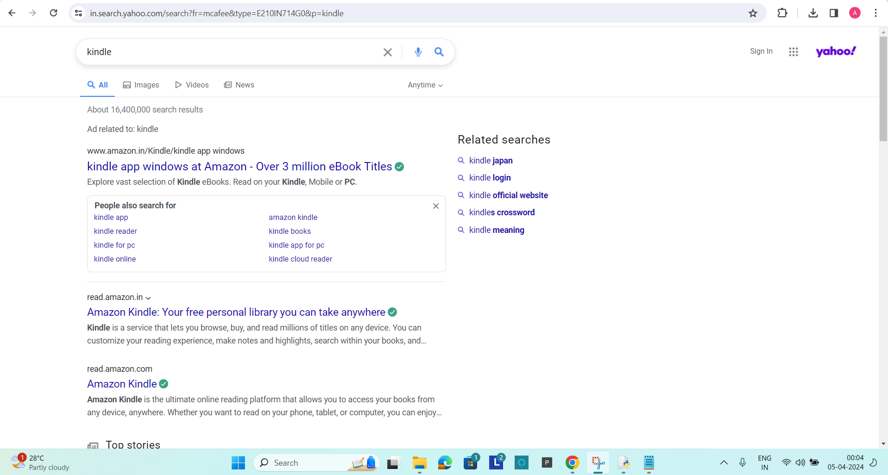
RESULT

Slide 14
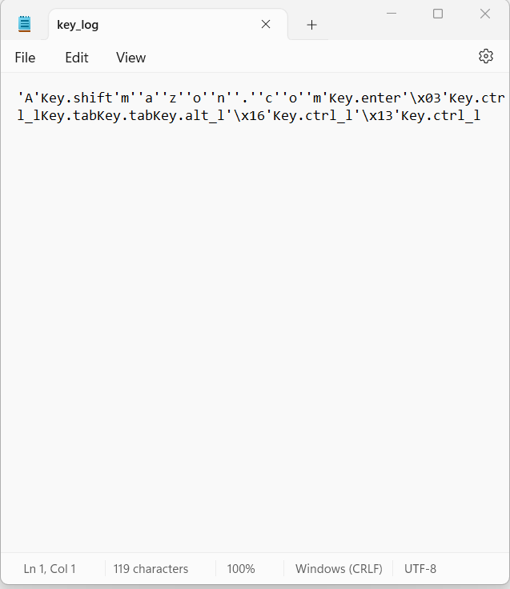
RESULT

Slide 15
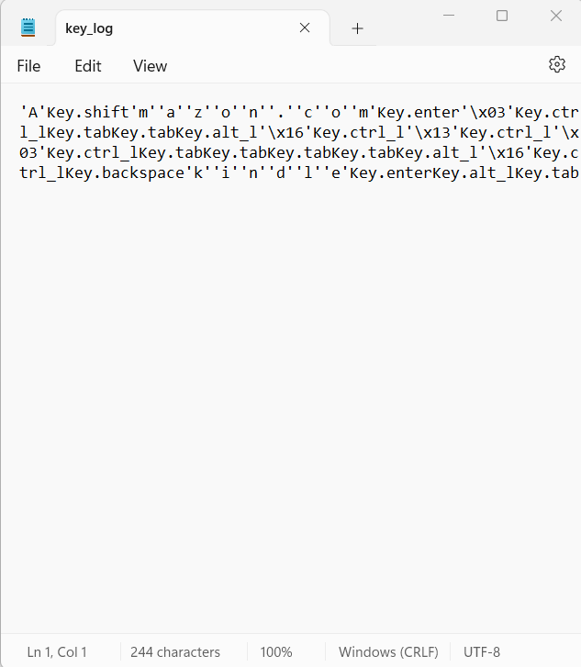
RESULT

Slide 16
CONCLUSION
The provided Python code presents a basic implementation of a keylogger using the pynput library for capturing keyboard events and tkinter for creating a simple GUI interface. The keylogger effectively records pressed, held, and released keys, storing the data in both text and JSON formats. It offers functionality to start and stop the keylogging process through the GUI, providing users with a straightforward means of controlling the logger.
While the current implementation fulfills its primary objective of logging keystrokes, there are several areas for improvement and expansion to enhance its functionality and usability.

Slide 17
FUTURE SCOPE
Increased Demand:
Potential for growth in cybersecurity and parental control.
Technological Advancements:
Malware developers may create more sophisticated keyloggers.
Keyloggers might be integrated into hardware for stealth.
Cloud-based logging could pose new privacy challenges.
Legal and Ethical Concerns:
Stricter privacy regulations may limit keylogger use.
Emphasis on transparency and user consent will rise.
Future Outlook:
Balance needed between utility and ethical user protection.
Public awareness about keyloggers is likely to increase.
Regulations around keylogger use may become stricter.

Slide 18
REFERENCES
Research Papers and Journals:
"A survey of keyloggers, detection and defence mechanisms" by Fadia Al Banaa and Thomas Owens (Journal of Information Security and Applications, Volume 39, 2018)
"Keylogging attacks and defences: A survey" by Alan Bartlett, Shirley Atkinson, and John N. Davies (Journal of Cyber Security Technology, Volume 1, 2017)
"A Comprehensive Review on Keyloggers and Their Detection Techniques" by Rana Moustafa and Sherif Elfayoumy (International Journal of Computer Applications, Volume 108, 2014)
M. Deshmukh, "Detecting Keylogger Attacks Using Machine Learning Techniques," International Journal of Advanced Research in Computer Science, 2017.

Slide 19
THANK YOU

